Slide 1
Everything You Ever Wanted to Know about Statistics
Prof. Andy Field

Slide 2
Aims and Objectives
Know what a statistical model is and why we use them.
  The mean
Know what the ‘fit’ of a model is and why it is important.
  The standard deviation
Distinguish models for samples and populations

Slide 3
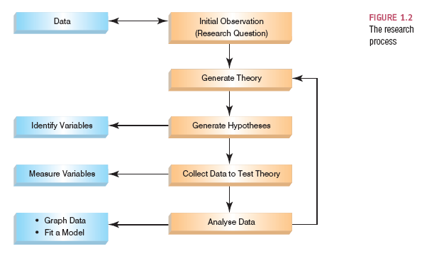
The Research Process

Slide 4
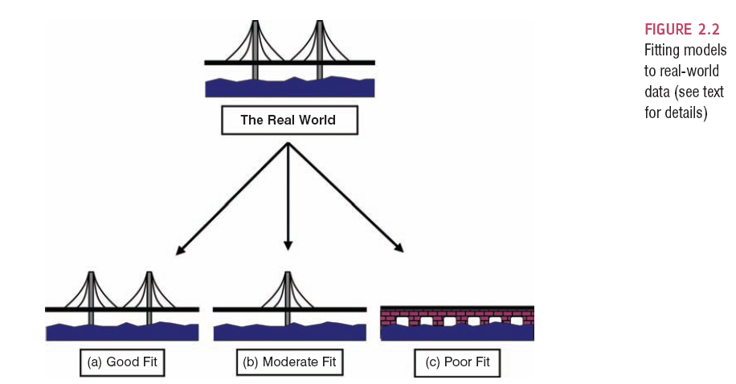
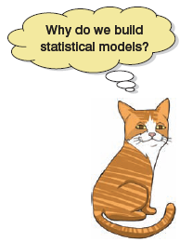

Slide 5
Populations and Samples
Population
  The collection of units (be they people, plankton, plants, cities, suicidal authors, etc.) to which we want to generalize a set of findings or a statistical model
Sample
  A smaller (but hopefully representative) collection of units from a population used to determine truths about that population

Slide 6
The Only Equation You Will Ever Need

Slide 7
A Simple Statistical Model
In statistics we fit models to our data (i.e. we use a statistical model to represent what is happening in the real world).
The mean is a hypothetical value (i.e. it doesn’t have to be a value that actually exists in the data set).
As such, the mean is simple statistical model.
Notes:
One of the simplest models we use in statistics is the mean. Some of you may have trouble thinking of the mean as a model, but in fact it is because it represents a summary of data. The mean is a hypothetical value that can be calculated for any data set, it doesn’t have to be a value that is actually observed in the data set. For example, if we took five statistics lecturers and measured the number of friends that they had, we might find the following data: 1, 3, 4, 3, 2. If we take the mean number of friends, this can be calculated by adding the values we obtained, and dividing by the number of values measured:. Now, we know that it is impossible to have 2.6 friends (unless you chop someone up with a chainsaw and befriend part of their remains, which in practice has proved disturbing) so the mean value is a hypothetical value. As such, the mean is a model that we create to summarise our data.

Slide 8
The Mean
The mean is the sum of all scores divided by the number of scores.
The mean is also the value from which the (squared) scores deviate least (it has the least error).

Slide 9
The Mean: Example
Collect some data:
1, 3, 4, 3, 2
Add them up:
Divide by the number of scores, n:

Slide 10
The mean as a model

Slide 11
Measuring the ‘Fit’ of the Model
The mean is a model of what happens in the real world: the typical score.
It is not a perfect representation of the data.
How can we assess how well the mean represents reality?

Slide 12
A Perfect Fit
Rating (out of 5)
Rater

Slide 13
Calculating ‘Error’
A deviation is the difference between the mean and an actual data point.
Deviations can be calculated by taking each score and subtracting the mean from it:

Slide 14
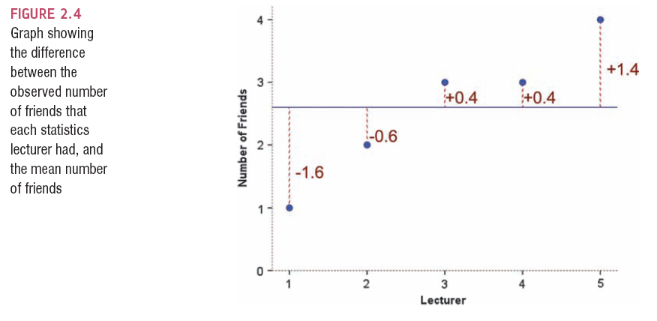

Slide 15
Use the Total Error?
We could just take the error between the mean and the data and add them.
Score | Mean | Deviation
1 | 2.6 | -1.6
2 | 2.6 | -0.6
3 | 2.6 | 0.4
3 | 2.6 | 0.4
4 | 2.6 | 1.4
 | Total = | 0

Slide 16
Sum of Squared Errors
We could add the deviations to find out the total error.
Deviations cancel out because some are positive and others negative.
Therefore, we square each deviation.
If we add these squared deviations we get the sum of squared errors (SS).

Slide 17
Score | Mean | Deviation | Squared Deviation
1 | 2.6 | -1.6 | 2.56
2 | 2.6 | -0.6 | 0.36
3 | 2.6 | 0.4 | 0.16
3 | 2.6 | 0.4 | 0.16
4 | 2.6 | 1.4 | 1.96
 |  | Total | 5.20

Slide 18

Variance
The sum of squares is a good measure of overall variability, but is dependent on the number of scores.
We calculate the average variability by dividing by the number of scores (n).
This value is called the variance (s²).

Slide 19

Degrees of Freedom
Sample
Population
11
7
8
8
12
15
?
9

Slide 20
Standard Deviation
The variance has one problem: it is measured in units squared.
This isn’t a very meaningful metric so we take the square root value.
This is the standard deviation (s).

Slide 21
Important Things to Remember
The sum of squares, variance, and standard deviation represent the same thing:
  The ‘fit’ of the mean to the data
  The variability in the data
  How well the mean represents the observed data
  Error

Slide 22
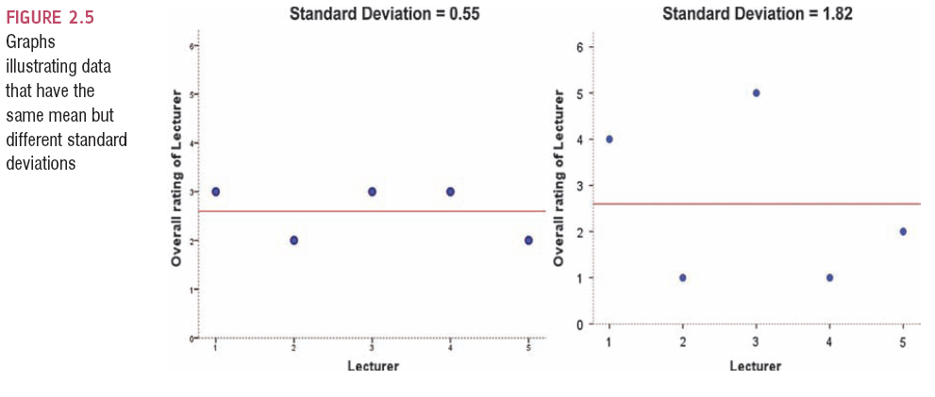
Same Mean, Different SD

Slide 23
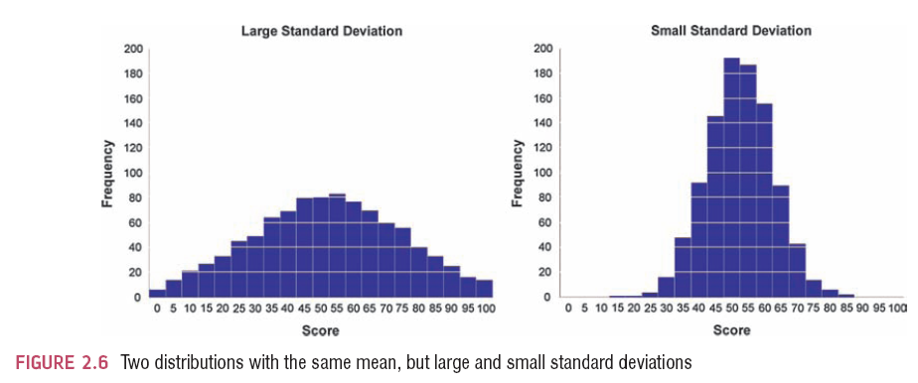
The SD and the Shape of a Distribution

Slide 24
Samples vs. Populations
Sample
  Mean and SD describe only the sample from which they were calculated.
Population
  Mean and SD are intended to describe the entire population (very rare in psychology).
Sample to Population:
  Mean and SD are obtained from a sample, but are used to estimate the mean and SD of the population (very common in psychology).

Slide 25
Sampling Variation

Slide 26
Population
μ = 10
M = 10
M = 9
M = 11
M = 10
M = 9
M = 8
M = 12
M = 10
M = 11

Slide 27
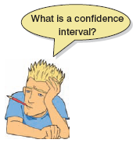
Confidence Intervals
Domjan et al. (1998)
  ‘Conditioned’ sperm release in Japanese quail.
True mean
  15 million sperm
Sample mean
  17 million sperm
Interval estimate
  12 to 22 million (contains true value)
  16 to 18 million (misses true value)
  CIs constructed such that 95% contain the true value.

Slide 28
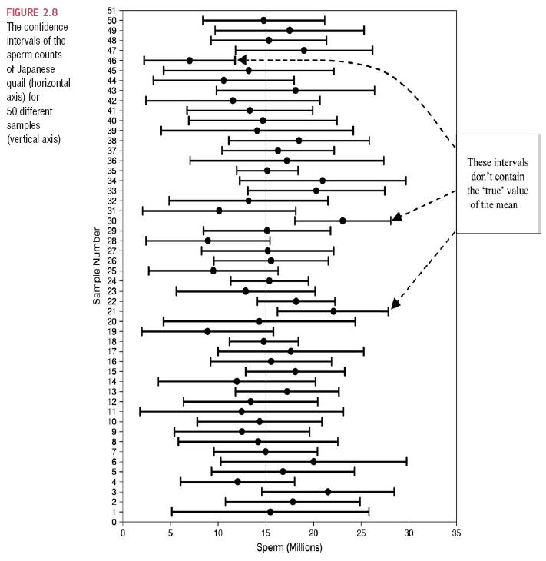

Slide 29
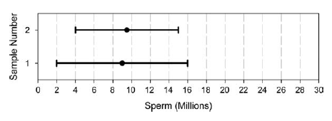
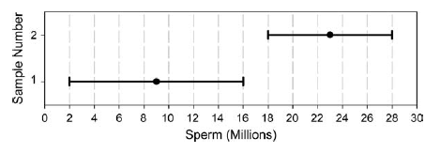

Slide 30

Test Statistics
A statistic for which the frequency of particular values is known.
Observed values can be used to test hypotheses.

Slide 31
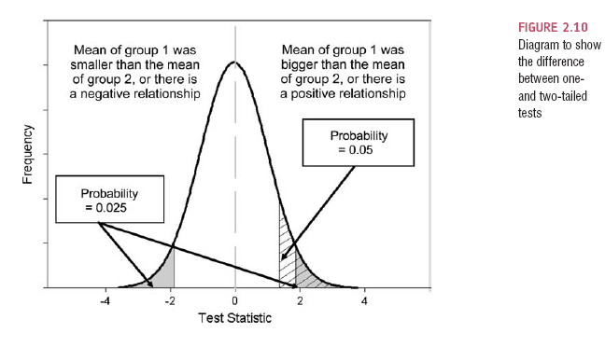
One- and Two-Tailed Tests

Slide 32
Type I and Type II Errors
Type I error
  occurs when we believe that there is a genuine effect in our population when, in fact, there isn’t.
  The probability is the α-level (usually .05)
Type II error
  occurs when we believe that there is no effect in the population when, in reality, there is.
  The probability is the β-level (often .2)

Slide 33
What Does Statistical Significance Tell Us?
The importance of an effect?
  No, significance depends on sample size.
That the null hypothesis is false?
  No, it is always false.
That the null hypothesis is true?
  No, it is never true.

Slide 34
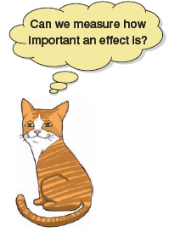
Effect Sizes
An effect size is a standardized measure of the size of an effect:
  Standardized = comparable across studies
  Not (as) reliant on the sample size
  Allows people to objectively evaluate the size of observed effect.

Slide 35
Effect Size Measures
r = .1, d = .2 (small effect):
  the effect explains 1% of the total variance.
r = .3, d = .5 (medium effect):
  the effect accounts for 9% of the total variance.
r = .5, d = .8 (large effect):
  the effect accounts for 25% of the variance.
Beware of these ‘canned’ effect sizes though:
  The size of effect should be placed within the research context.

Slide 36
Effect Size Measures
There are several effect size measures that can be used:
  Cohen’s d
  Pearson’s r
  Glass’ Δ
  Hedges’ g
  Odds ratio/risk rates
Pearson’s r is a good intuitive measure
  Oh, apart from when group sizes are different …

